Slide 1
Notes:
Chapter Fourteen
Project Closure

Slide 2
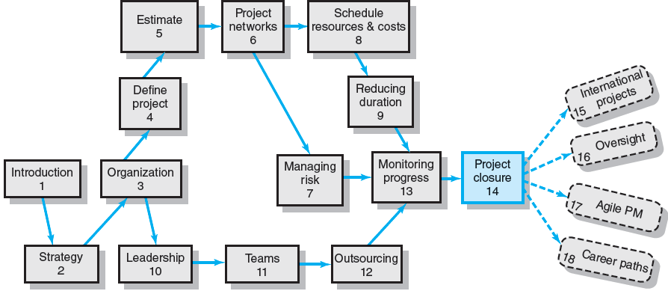
Where We Are Now
Notes:
Chapter 14 covers how the goals of project closure are to complete the project and to improve performance of future projects. Implementing closure and review has three major closure deliverables: wrap-up, evaluation, and retrospectives. Wrap-up closure activities include delivering the final project deliverable, closing accounts, finding new opportunities for project staff, closing facilities, and creating the final report.
Project evaluation verifies and documents project performance. The retrospectives methodology promises lessons learned are identified and used. Too often massive dollars are spent planning a project and little to nothing is spent on learning from the experience of completing the project. Failure to review, assess, and record successes and failures has consistently proven to be a costly waste. Retrospective methodology addresses this waste.

Slide 3
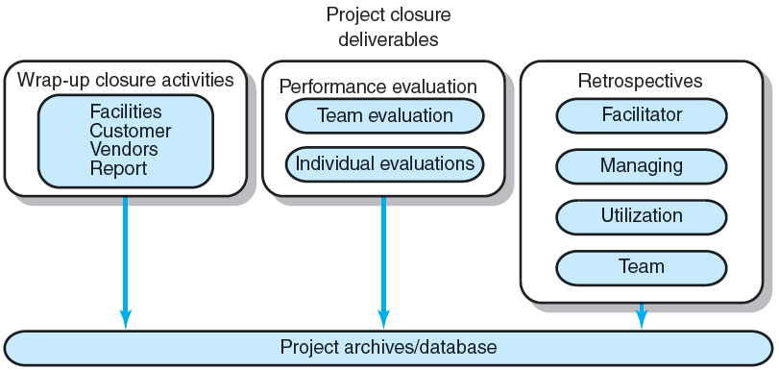
Project Closure and Review Deliverables
FIGURE 14.1
Notes:
Figure 14.1 shows the three major deliverables for project closure: wrap-up closure activities, performance evaluation, and retrospectives. Closing out a project includes recording and storing records of wrap-up closure activities, performance evaluations, and retrospectives in the organization’s project archives/database. In today’s project-driven organizations that have many projects occurring simultaneously, the responsibility for completing closure tasks has been parsed among the project manager, project teams, project office, an oversight “review committee,” and an independent retrospective facilitator. Many tasks overlap, occur simultaneously, and require coordination and cooperation among these stakeholders.

Slide 4
Project Closure
Types of Project Closure
Normal
Premature
Perpetual
Failed Project
Changed Priority
Close-out Plan: Questions to be Asked
What tasks are required to close the project?
Who will be responsible for these tasks?
When will closure begin and end?
How will the project be delivered?
Notes:
Types of Project Closure
Normal closure happens when a project is normally completed
Premature closure occurs when a project completes early due to the elimination of some parts of the project.
Perpetual projects must reach final closure at some point due to other scheduling necessities.
Closure of failed projects must include the technical (or other) reasons for termination of the project.
Projects are altered or closed when changes in an organization’s strategy, direction, and priorities remove the reasons for continuing the project.
Questions that should be asked when developing a close-out plan:
What tasks are required to close the project?
Who will be responsible for these tasks?
When will closure begin and end?
How will the project be delivered?

Slide 5
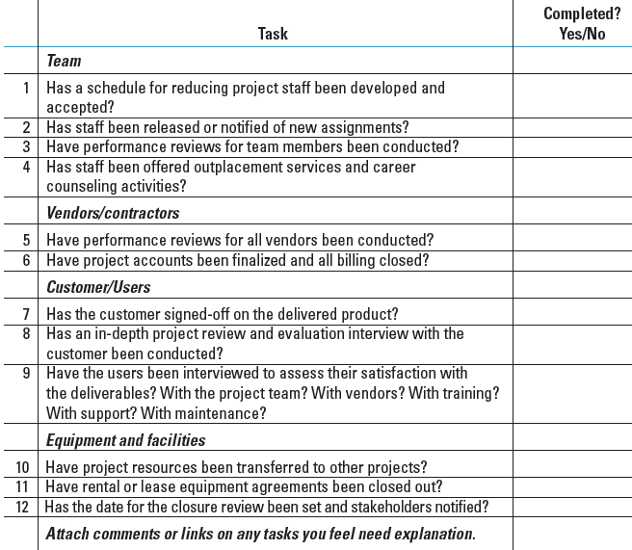
Wrap-up Closure Checklist
TABLE 14.1
Notes:
Table 14.1 shows a partial administrative closure checklist for project teams to use to deal with closure details such as facilities, teams, staff, customer, vendors, and the project itself.

Slide 6
Implementing Project Closedown
Getting delivery acceptance from the customer.
Shutting down resources and releasing them to new uses.
Evaluating the team, team members and the project manager; and reassigning project team members.
Closing accounts and paying all bills.
Delivering the project to the customer.
Creating a final report.
Notes:
Implementing the closure process includes several wrap-up activities. Many organizations develop lengthy lists for closing projects as they gain experience. These are very helpful and ensure nothing is overlooked. Implementing closedown includes the following six major activities:
Getting delivery acceptance from the customer, sometimes using a BOOT tactic (build, own, operate. transfer)
Shutting down resources and releasing to new uses.
Evaluating and reassigning project team members.
Closing accounts and seeing all bills are paid.
Delivering the project to the customer.
Creating a final report.

Slide 7
Creating the Final Report
Executive Summary
Project goals met/unmet
Stakeholder satisfaction with project
User reactions to quality of deliverables
Review and Analysis
Project mission and objective
Procedures and systems used
Organization resources used
Recommendations
Technical improvements
Corrective actions
Lessons Learned
Reminders
Retrospectives
Appendix
Backup data
Critical information
Notes:
The final project report summarizes project performance and provides useful information for continuous improvement. Although the final report will be customized to a particular project and organization, the content of the final report typically includes the following topics and subtopics:
Executive Summary
Project goals met/unmet
Stakeholder satisfaction with project
User reactions to quality of deliverables
Review and Analysis
Project mission and objective
Procedures and systems used
Organization resources used
Recommendations
Technical improvements
Corrective actions
Lessons Learned
Reminders
Retrospectives
Appendix
Backup data
Critical information

Slide 8
Project Performance Evaluations
Reasons for Poor-Quality Project Performance Evaluations:
Evaluations of individuals are left to supervisors of the team member’s home department.
Typically measure team performance only on time, cost, and specifications.
Notes:
Reasons for poor-quality project performance evaluations are that:
Evaluations of individuals are left to supervisors of the team member’s home department who are unfamiliar with the team member’s contributions as a project team members.
Project evaluations typically measure team performance only on time, cost, and specifications.

Slide 9
Pre-Implementation Conditions: Team
Are standards and goals for measuring performance clear, challenging, and attainable? Lead to positive consequences?
Are responsibilities and performance standards known by all team members?
Are team rewards adequate? Management believes teams are important?
Is there a career path for successful project managers
Does the team have discretionary authority to manage short-term difficulties?
Is there a high level of trust within the organization culture?
Are there criteria beyond time, cost, and specifications?
Notes:
Before an evaluation of the project team can be effective and useful, a minimum core of conditions needs to be in place before the project begins. Some typical conditions are listed here in the form of questions:
Are standards and goals for measuring performance clear, challenging, and attainable? Do they lead to positive consequences?
Are individual responsibilities and performance standards known by all team members?
Are team rewards adequate? Do they send a clear signal that senior management believes that the synergy of teams is important?
Is a clear career path for successful project managers in place?
Is the team empowered to manage short-term difficulties?
Is there a relatively high level of trust emanating from the organizational culture?
Are there evaluation criteria beyond time, cost, and specifications?

Slide 10
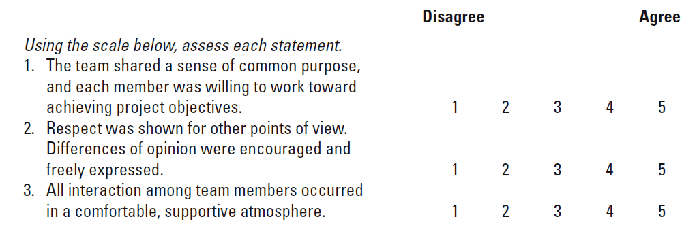
Sample Team Evaluation and Feedback Survey
TABLE 14.2
Notes:
Table 14.2 presents an example of a partial survey that uses a disagree-to-agree scale for its evaluation items. After the results are tabulated, the team meets with the facilitator and/or senior management, and the results are reviewed to assess the development of the team, its strengths and weaknesses, and the lessons that can be applied to future project work.

Slide 11
Project Performance Evaluation: Individual
Performance Assessment Responsibilities:
Functional organization or functional matrix: the individual’s area manager.
The area manager may solicit the project manager’s opinion of the individual’s performance on a specific project.
Balanced matrix: the project manager and the area manager jointly evaluate an individual’s performance.
Project matrix and project organizations: the project manager is responsible for appraising individual performance.
Notes:
Assignment of individual performance assessment responsibilities is depends largely on the structure of the organizational.
For functional organizations or organizations that use a functional matrix, the individual’s area manager may solicit the project manager’s opinion of the individual’s performance on a specific project.
In a balanced matrix organization, the project manager and the area manager jointly evaluate an individual’s performance.
In project matrix and project organizations: the project manager is responsible for appraising individual performance.

Slide 12
Conducting Performance Reviews
Begin by asking the individual to evaluate his or her own performance.
Avoid drawing comparisons with other team members; rather, assess the individual in terms of established standards and expectations.
Focus criticism on specific behaviors rather than on the individual personally.
Be consistent and fair in treatment of all team members.
Treat the review as one point in an ongoing process.
Notes:
The following are general tips for conducting performance reviews of individual project team members:
Begin by asking the individual to evaluate his or her own performance to reduce the judgmental nature of the assessment.
Avoid drawing comparisons with other team members; rather, assess the individual in terms of established standards and expectations.
Focus criticism on specific behaviors rather than on the individual personally.
Be consistent and fair in treatment of all team members.
Treat the review as one point in an ongoing process to improve an individual’s performance.

Slide 13
Individual Performance Assessment
Multiple rater appraisal (“360-degree feedback)
Involves soliciting feedback concerning team members’ performance from all of the people that their work affects.
Project managers, area managers, peers, subordinates, and customers.
Notes:
Multiple rater appraisal (“360-degree feedback) is intended to develop broad-based view of an individual’s performance by soliciting feedback concerning their performance as a team members from all of the people that their work affects. Sources include project managers, area managers, peers, subordinates, and customers.

Slide 14
Retrospectives
Lessons Learned
An analysis carried out during and shortly after the project life cycle to capture positive and negative project learning—“what worked and what didn’t?”
Goals of Retrospectives
To reuse learned solutions
To stop repetitive mistakes
Notes:
Retrospectives are based on the lessons learned from an analysis carried out during and shortly after the project life cycle to capture positive and negative project learning—answering the questions of “what worked and what didn’t?” for a project.
Goals of retrospectives are to reuse learned solutions and to stop repetitive mistakes.

Slide 15
Retrospectives (cont’d)
Barriers to Organizational Learning
Lack of post-project time for developing lessons
No post-project direction or support for teams
Lessons become blame sessions
Lessons are not applied in other locations
Organizational culture does not recognize value of learning
Notes:
Barriers to organizational learning from the retrospective process include:
Lack of post-project time for developing lessons
No post-project direction or support for teams
Lessons become blame sessions
Lessons are not applied in other locations
Organizational culture does not recognize value of learning

Slide 16
The Value of Retrospective Analyses
Making Retrospectives Effective:
Use an independent facilitator to guide the project team through the analysis project activities.
Include a minimum of three in-process learning gates during the life project cycle.
Designate a team member as owner for each point in the retrospective.
Develop an easy-to-use learning repository to ensure future utilization of retrospective lessons.
Mandate use of retrospectives as part of the normal process for all projects.
Notes:
Ways in which organizations can make effective use of retrospectives include:
Using an independent facilitator to guide the project team through the analysis project activities.
Including a minimum of three in-process learning gates during the life project cycle.
Designating a team member as owner for each point in the retrospective.
Developing an easy-to-use learning repository to ensure future utilization of retrospective lessons.
Mandating use of retrospectives as part of the normal process for all projects.

Slide 17
Characteristics of a Closure Facilitator
No direct involvement or direct interest in the project.
Perceived as impartial and fair
Respect of senior management and other project stakeholders.
Willingness to listen.
Independence and authority to report audit results without fear of recriminations from special interests.
Perceived as having the best interests of the organization in making decisions.
Broad-based experience in the organization or industry.
Notes:
Characteristics of an effective independent closure facilitator include:
No direct involvement or direct interest in the project.
Perceived as impartial and fair
Respect of senior management and other project stakeholders.
Willingness to listen.
Independence and authority to report audit results without fear of recriminations from special interests.
Perceived as having the best interests of the organization in making decisions.
Broad-based experience in the organization or industry.

Slide 18
Initiating the Retrospective Review
Have automatic times or points when audits will take place. Avoid surprises.
Conduct audits carefully and with sensitivity.
Audit staff must independent from the project.
Audit reports need to be used and accessible.
Audits support organizational culture.
Project closures should be planned and orderly.
Certain “core conditions” must be in place to support team and individual evaluation.
Conduct individual and team evaluations separate from pay or merit reviews.
Notes:
Initiating the retrospective review process in an organization should be a normal process based on that includes the following considerations:
Have automatic times or points when audits will take place. Avoid surprises.
Conduct audits carefully and with sensitivity.
Audit staff must independent from the project.
Audit reports need to be used and accessible.
Audits support organizational culture
Project closures should be planned and orderly.
Certain “core conditions” must be in place to support team and individual evaluation.
Conduct individual and team evaluations separate from pay or merit reviews.

Slide 19
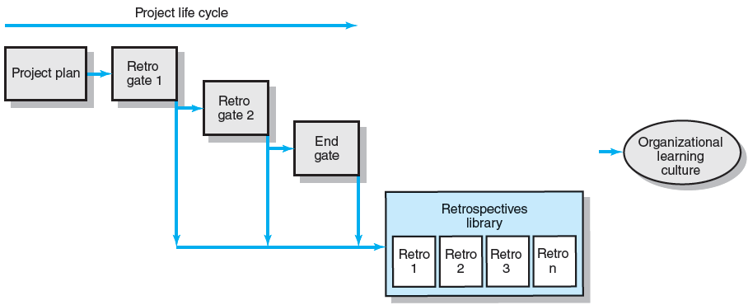
The Retrospectives Process
FIGURE 14.2
Notes:
Figure 14.2 shows a flow chart of the use of three interim retrospectives within an organizational learning culture in gathering lessons learned during a project’s life cycle and then storing them for reuse in changing unfinished work.

Slide 20
Conducting a Retrospective Analysis
Initiation and staffing
Data collection and analysis
Reporting
Notes:
Conducting a retrospective analysis involves three steps
Initiation and staffing
Data collection and analysis
Reporting of lessons learned findings

Slide 21
Project Process Review Questionnaire
Were the project objectives and strategic intent of the project clearly and explicitly communicated?
Were the objectives and strategy in alignment?
Were the stakeholders identified and included in the planning?
Were project resources adequate for this project?
Were people with the right skill sets assigned to this project?
Were time estimates reasonable and achievable?
Were the risks for the project appropriately identified and assessed before the project started?
Were the processes and practices appropriate for this type of project? Should projects of similar size and type use these systems? Why/why not?
Did outside contractors perform as expected? Explain.
Were communication methods appropriate and adequate among all stakeholders? Explain.
Is the customer satisfied with the project product?
Are the customers using the project deliverables as intended? Are they satisfied?
Were the project objectives met?
Are the stakeholders satisfied their strategic intents have been met?
Has the customer or sponsor accepted a formal statement that the terms of the project charter and scope have been met?
Were schedule, budget, and scope standards met?
Is there any one important area that needs to be reviewed and improved upon? Can you identify the cause?
TABLE 14.3
Notes:
Table 14.3 lists some typical questions that could be used in a project process and methods review questionnaire that is distributed to all major project stakeholders for responses.

Slide 22
Organizational Culture Review Questionnaire
Was the organizational culture supportive for this type of project?
Was senior management support adequate?
Were people with the right skills assigned to this project?
Did the project office help or hinder management of the project? Explain.
Did the team have access to organizational resources (people, funds, equipment)?
Was training for this project adequate? Explain.
Were lessons learned from earlier projects useful? Why? Where?
Did the project have a clear link to organizational objectives? Explain.
Was project staff properly reassigned?
Was the Human Resources Office helpful in finding new assignments? Comment.
TABLE 14.4
Notes:
Table 14.4 lists a sampling of items for questionnaire surveying organizational culture to assess which fundamental organizational culture properties could affect project successes and failures or could become a hindrance to project teams.

Slide 23
Archiving Retrospectives
Classifying of Projects:
Project type
Size
Staffing
Technology level
Strategic or support
Issues and problems
Project mission and objectives
Procedures and systems used
Organization resources used
Notes:
It is critical to have a repository where reports and retrospective/lessons learned are accessible and easily retrieved if the retrospectives are to be used. This is usually done using a Web site or other electronic means that allows each project review to be categorized based on differences in the way projects with different characteristics are managed and handled in an organization. The classification of projects by characteristics allows prospective readers, teams, and project managers to be selective in the search and use of report content.

Slide 24
Key Terms
Lessons learned
Performance review
Project closure
Project evaluation
Project facilitator
Retrospective
Team evaluation
360-degree review
Notes:
Lessons learned are used to improve the management of future projects
Performance review encompasses all review methods of individual performance that center on the technical and social skills brought to the project and team.
Project closure involves all of the major activities of shutting down a project: evaluation of project goals and performance, developing lessons learned, releasing resources, and preparing a final report.
Project evaluation is the process of assessing, verifying, and documenting project results.
Project facilitator is a guide who leads the project team through an analysis of project activities that went well, what needs improvement, and development of a follow-up action plan with goals and accountability.
Retrospective is a methodology that analyzes a past project event to determine what worked and what didn’t, develops lessons learned, and creates an action plan that ensures lessons learned are used to improve management of future projects.
Team evaluation is the process of evaluating the performance of the project team using a minimum core of initial conditions that emphasizes the team as a whole, while minimizing individual performance.
360-degree review is a multirater appraisal system based on performance information that is gathered from multiple sources (superiors, peers, subordinates, customers).

Slide 25
Project Closeout Checklist

Slide 26
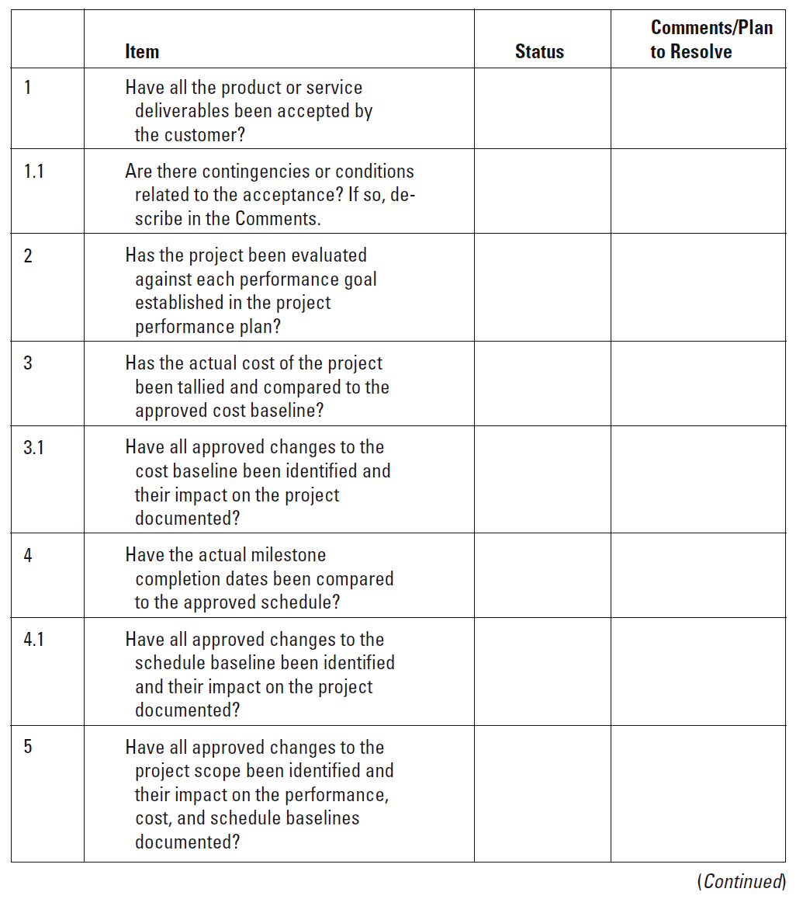
Project Closeout Checklist
Notes:
The Project Closeout Checklist contains questions about the status of various items and what additional actions are needed, if any, are needed to resolve any issues.

Slide 27
Euro Conversion—Project Closure Checklist

Slide 28
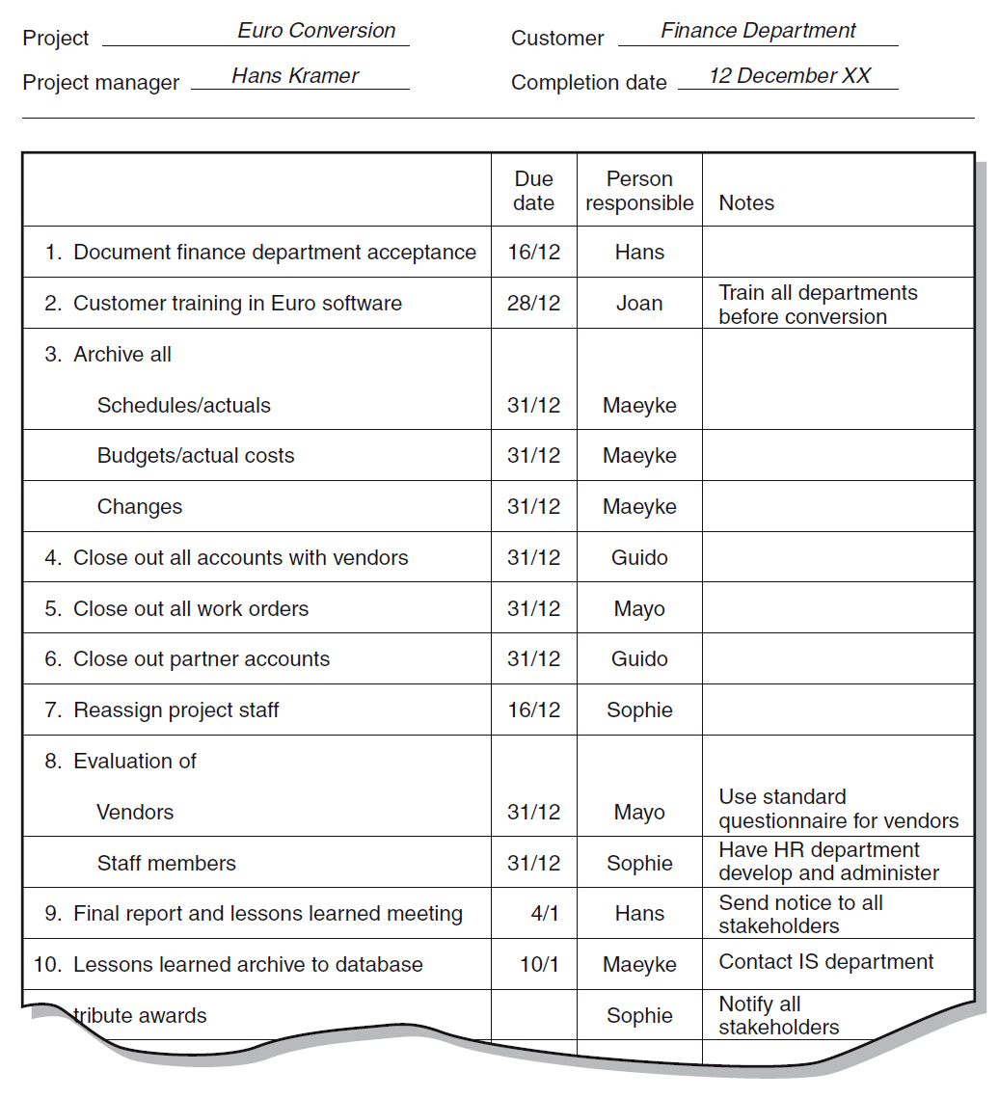
Euro Conversion—Project Closure Checklist
Notes:
The Euro Conversion—Project Closure Checklist identifies the action items, due dates, people responsible, and any notes related to the action items.

